Slide 1
Enhancing copies in the Core of Relational Databases
November 11th, 2022

Slide 2
01 – Previous meeting wrap up
02 – Current status
03 – Next steps

Slide 3
01
Previous meeting wrap up

Slide 4
Previous meeting comments
Integrate the regularization term inside the loss function.
Simple UCI databases.
Incremental learning (toy problem).

Slide 5
02
Current status

Slide 6
Current Status
01
UCI datasets. Provisional plots

Slide 7
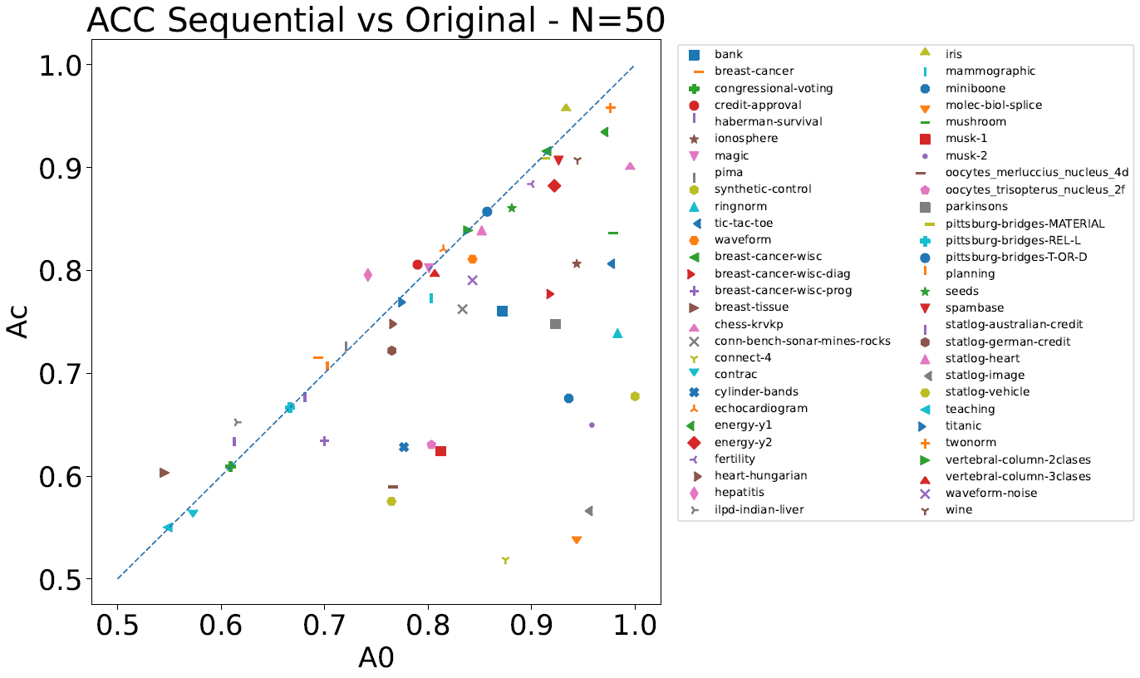
UCI datasets: Provisional plots
No fine tunning
3 𝛌
2 𝛒
1 N
Same Network architecture
We need to compare with the single-pass approach!

Slide 8
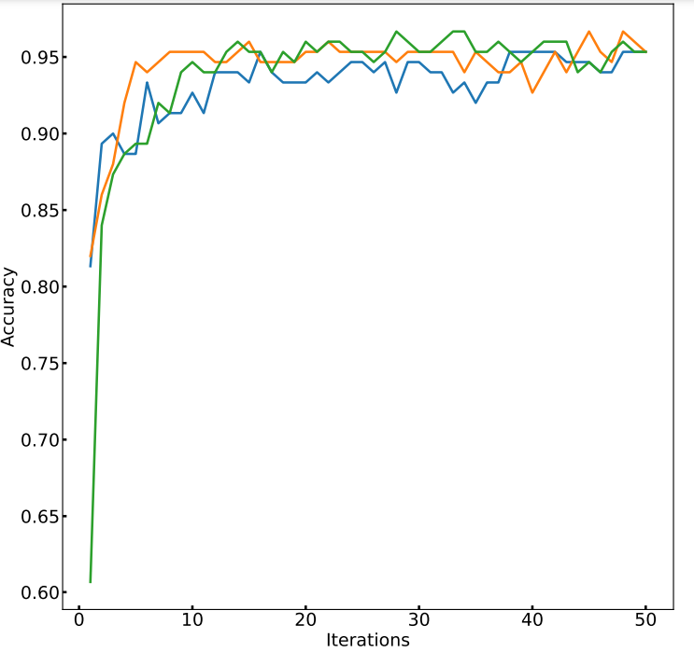

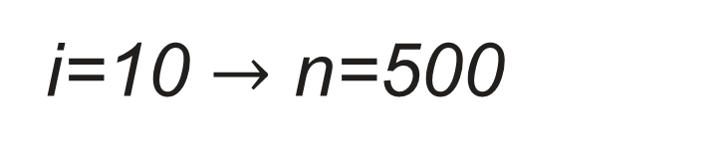
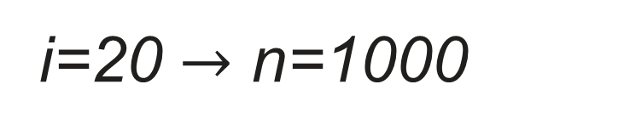
UCI datasets: Provisional plots
Iris dataset
We choose the iteration where the acc curve stabilize and its middle point.
These two values are used to calculate the single pass with i*N data points.
The value of the acc for the single pass with the largest N is consider as single pass acc.
We compared it with the best sequential approach at this iteration.
i=20 $→$ n=1000
i=10 $→$ n=500

Slide 9
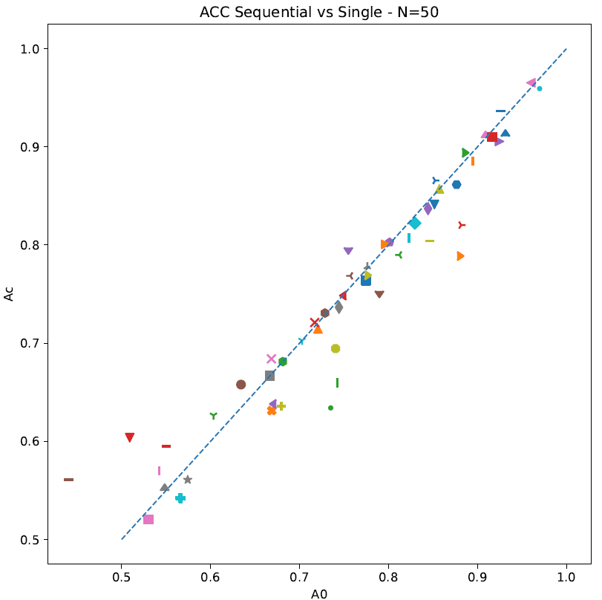
UCI datasets: Provisional plots
Iris dataset
Sequential and single pass perform equally.
Remember no fine tuning!.
Acc_{sequential}
Acc_{single pass}

Slide 10
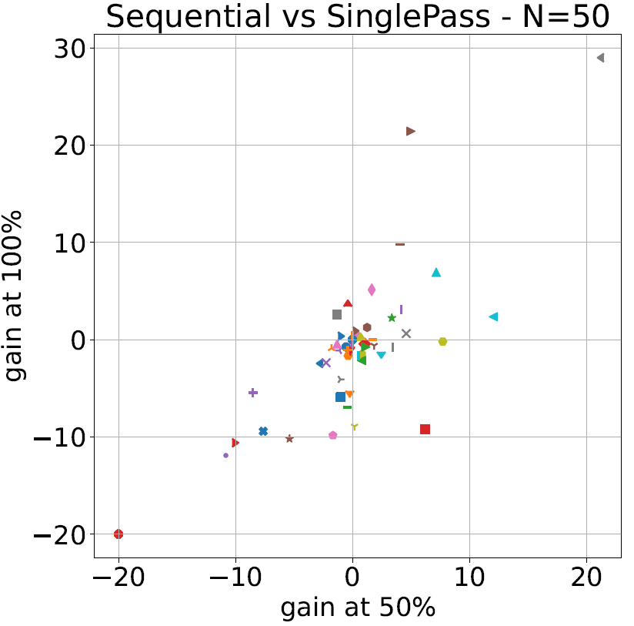
UCI datasets: Provisional plots
Acc difference between sequential and single pass.
y-axis stable Acc, x-axis middle point.
All points should be around (0,0) since both approaches had shown a similar performance.
Noise in the performance is ∼5%.
Too little statistics (only 5 independent runs)
What should we expect if we increase N?
Iris dataset

Slide 11
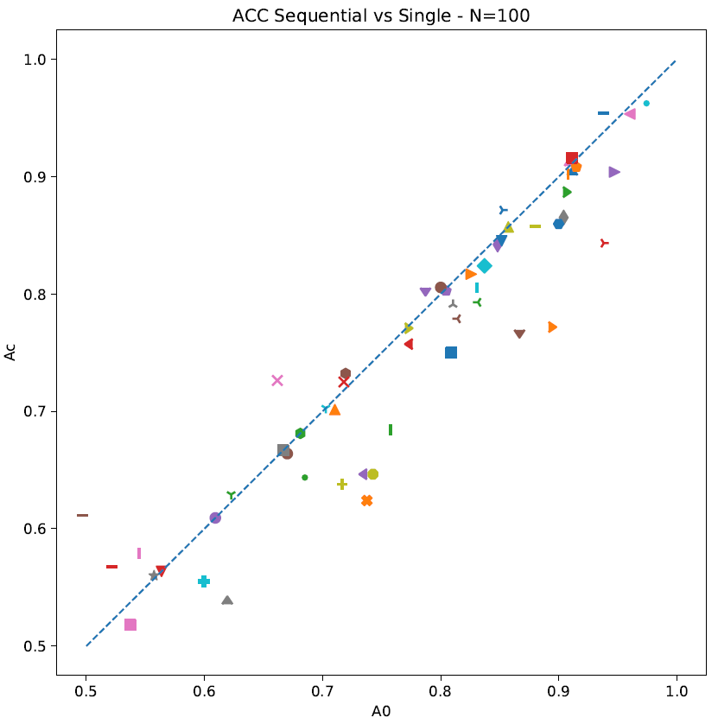
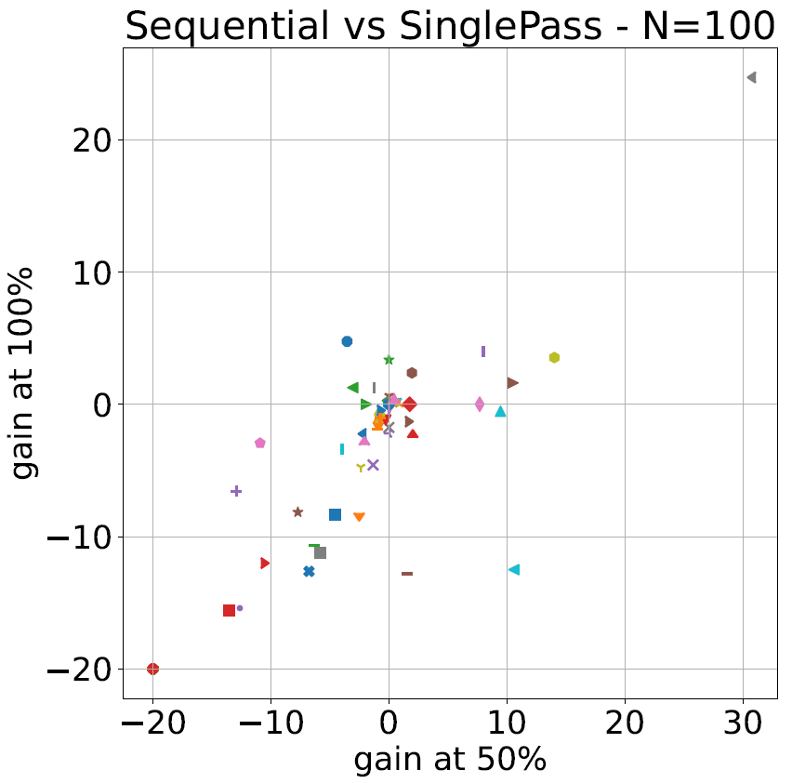
UCI datasets: Provisional plots
Single pass has a better performance.
This is not true; the Acc metric is unfair. Single pass uses more data points for training.
We are designing a better measure (we must adjust a bit 𝛌 and 𝛒).
Acc_{sequential}
Acc_{single pass}

Slide 12
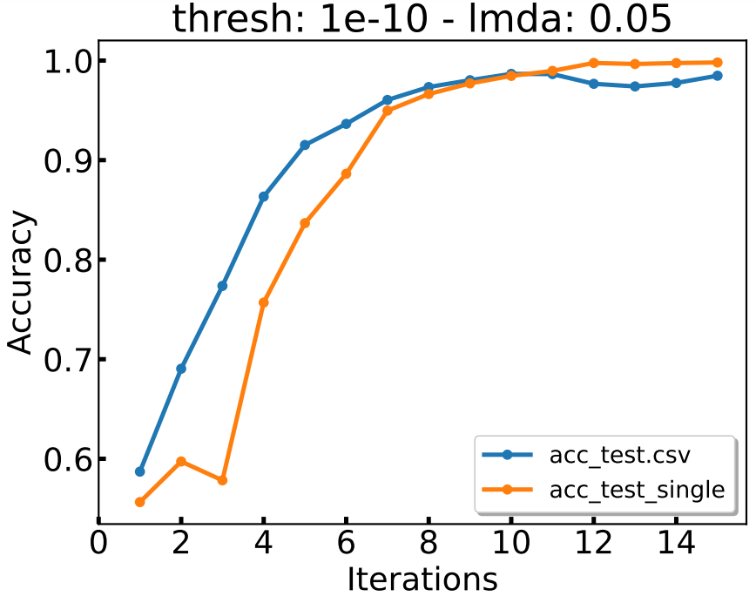
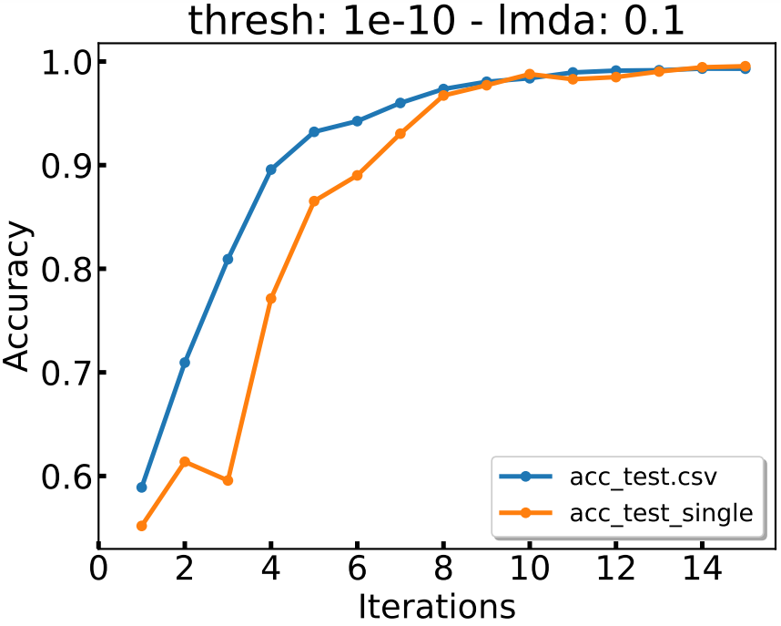
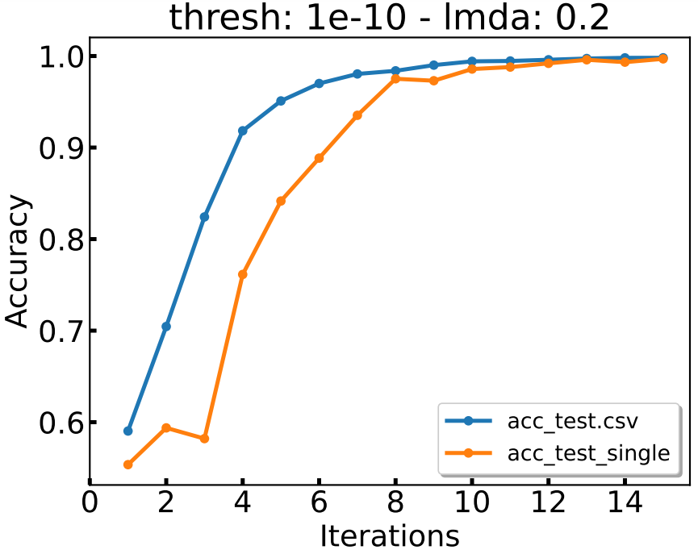
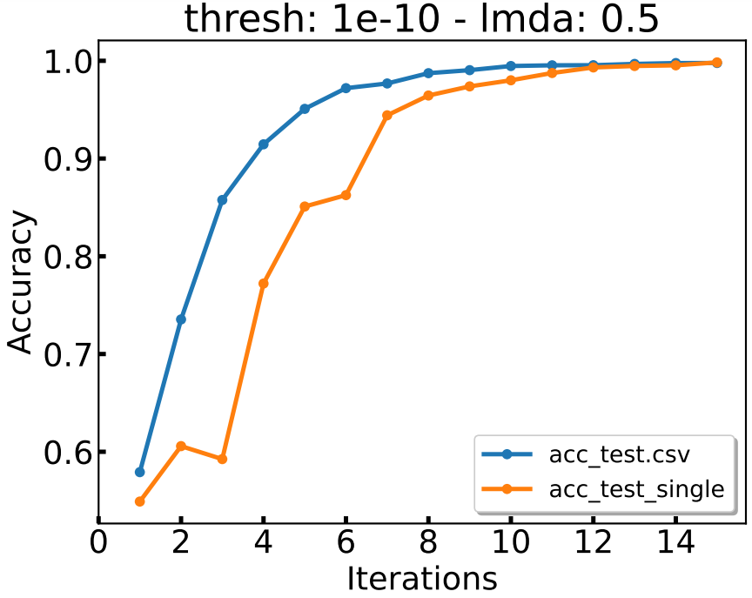
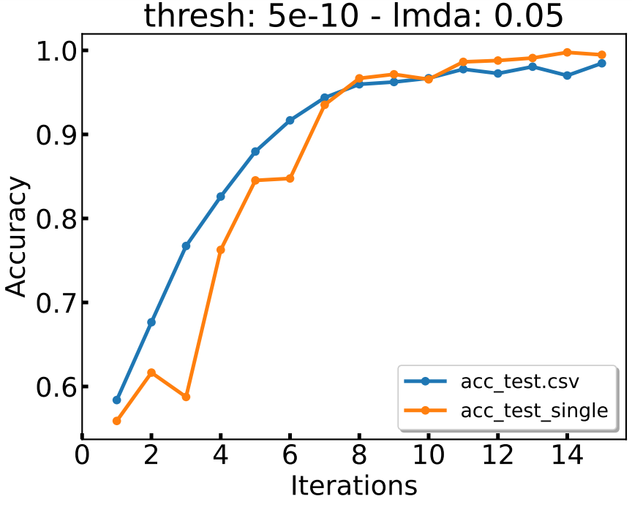
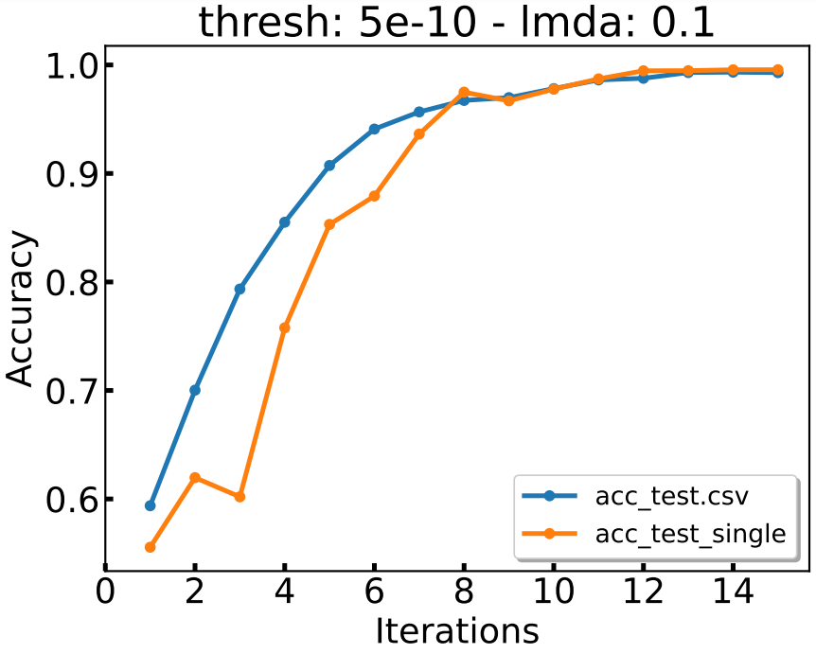
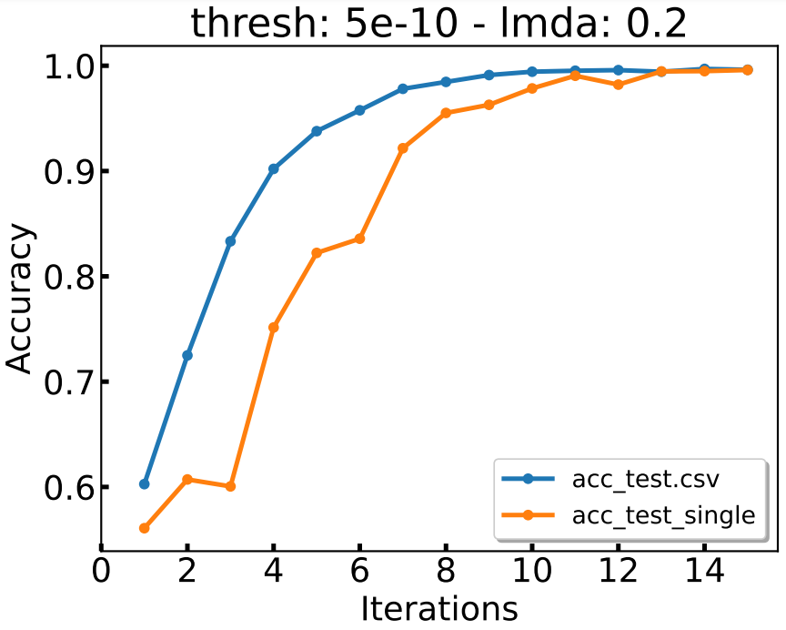
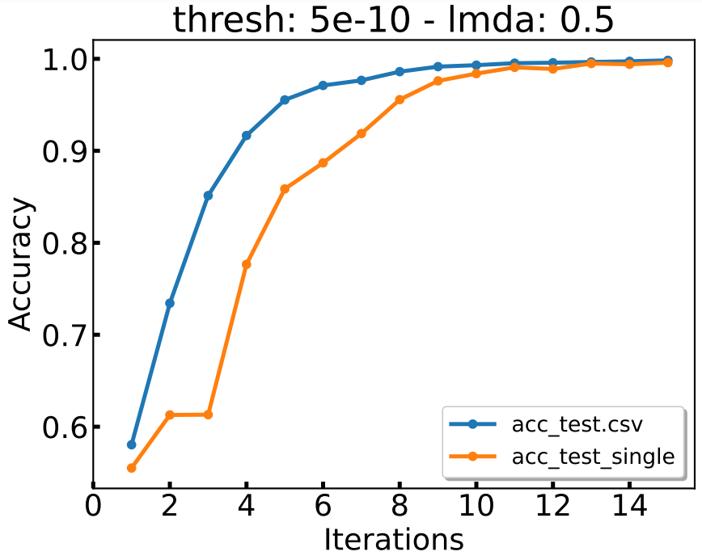
Spirals dataset with N = 75

Slide 13
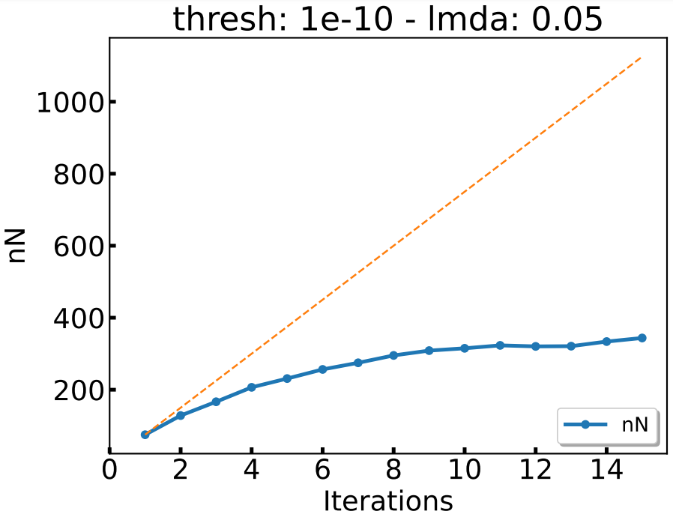
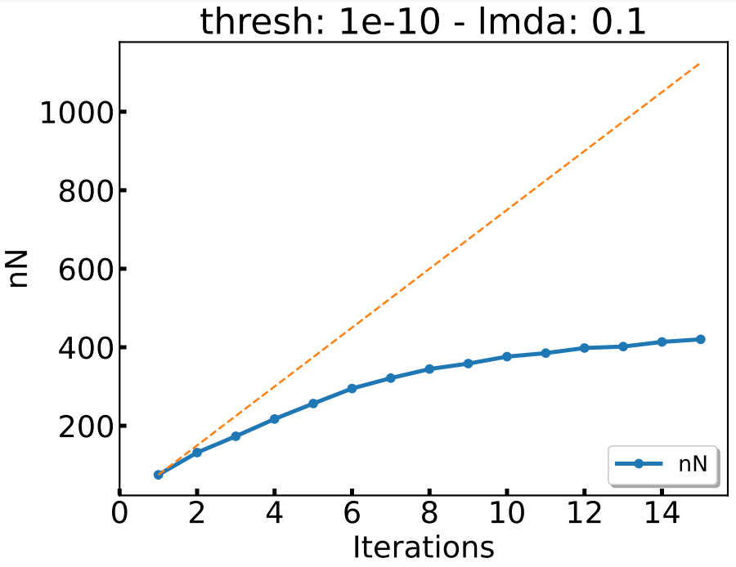
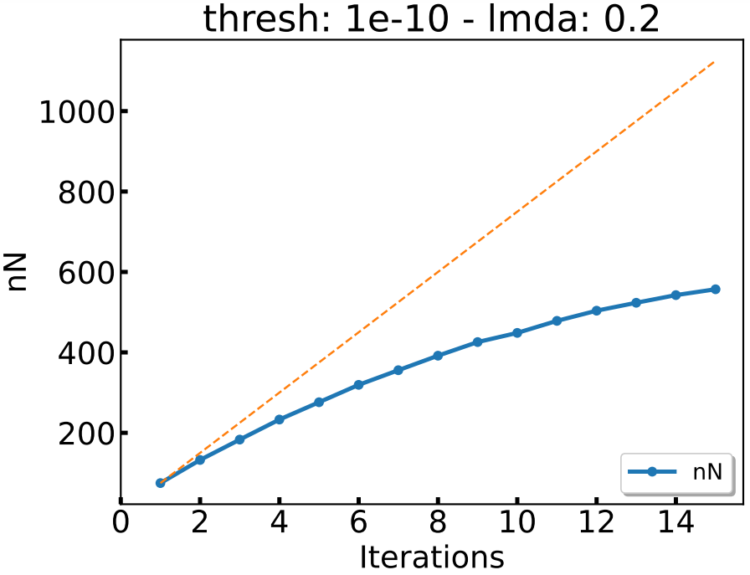
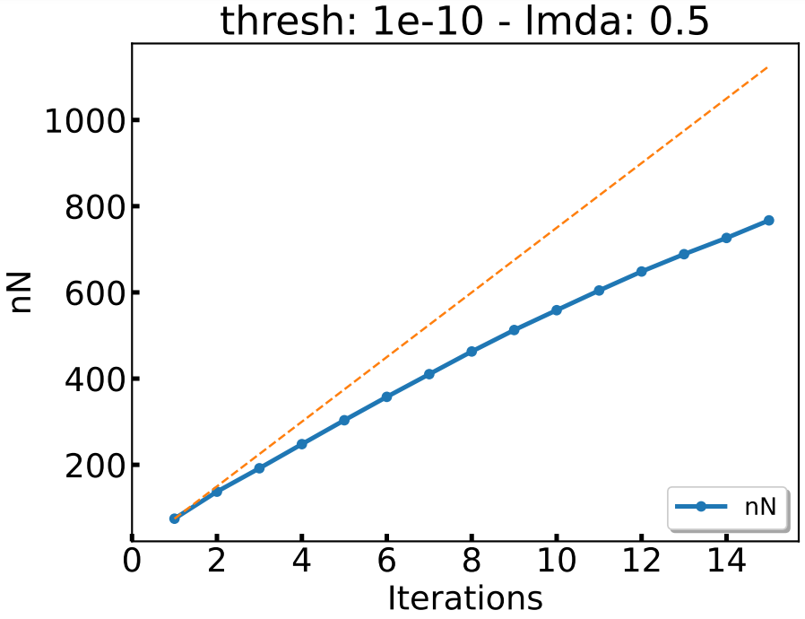
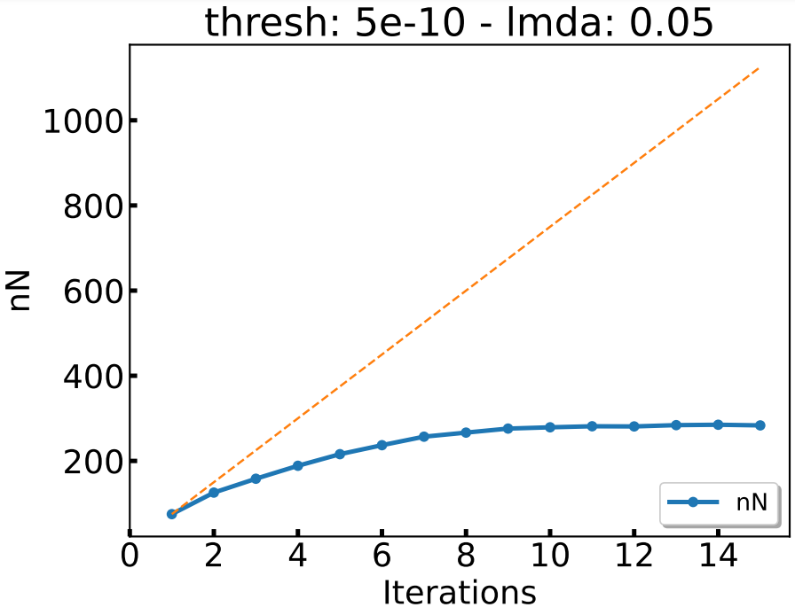
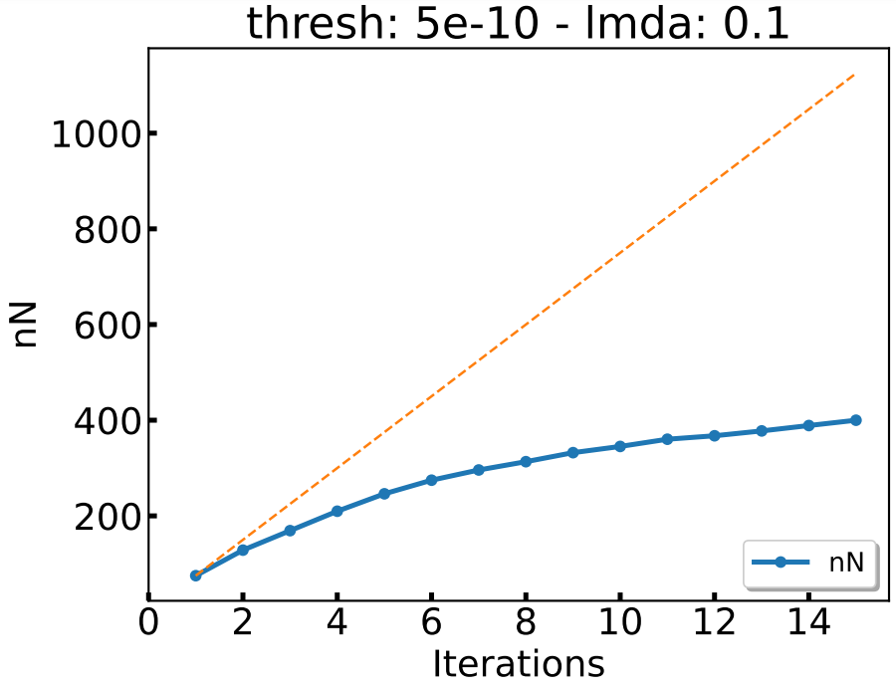
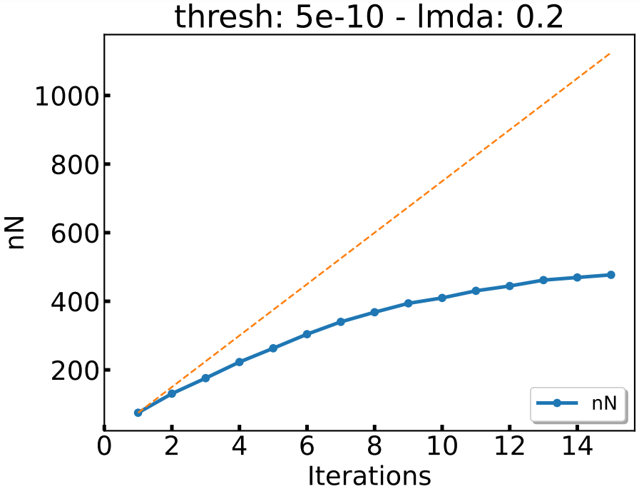
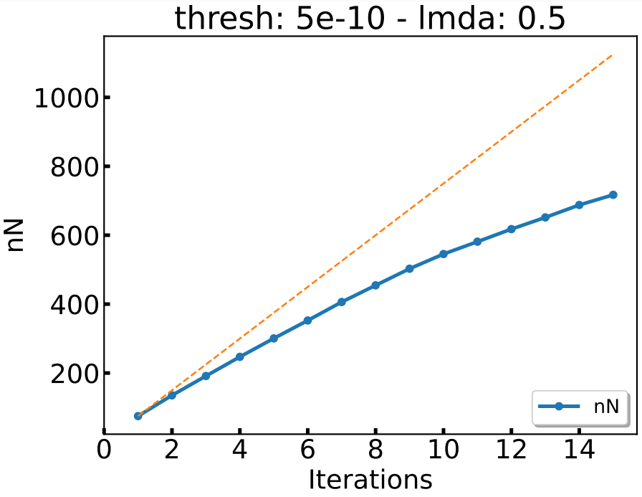
Spirals dataset with N = 75

Slide 14
03
Next Steps

Slide 15
Next Steps
01
Repeat the UCI with ajusted parameters computing the AUC difference.
02
Use case. Any idea? (COVID issue)

Slide 17
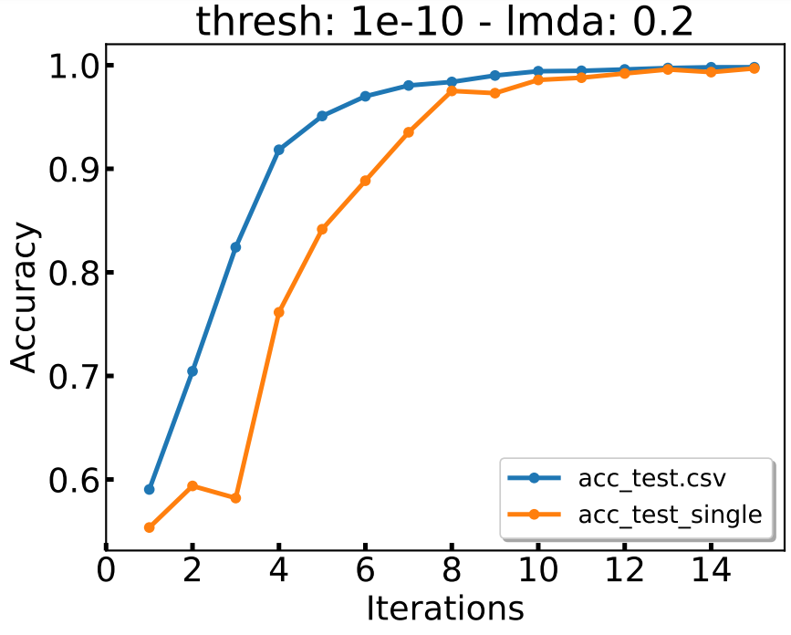
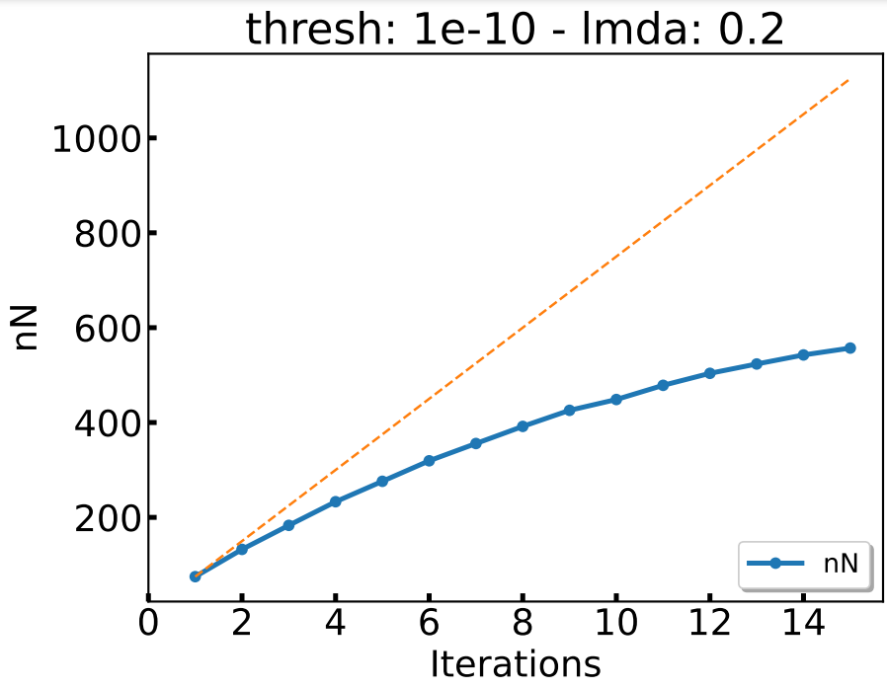
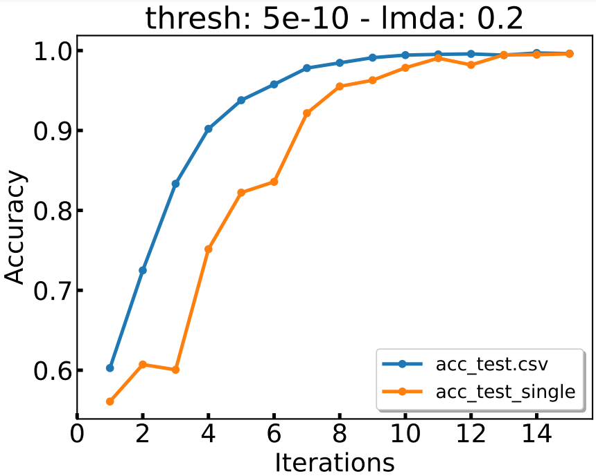

590
Spirals dataset with N = 75.
In both cases, sequential wins at each iteration to singlepass, however, the number of points can be reduced wihtout an impact on the accuracy by tunning the dropping threshold and the lambda.
480

